Slide 1
Identifying novel functional linear motifs using host-viral protein interactions and the principle of convergent evolution
Vitalii Kleshchevnikov
Evangelia Petsalaki’s group (Whole Cell Signalling)

Slide 2
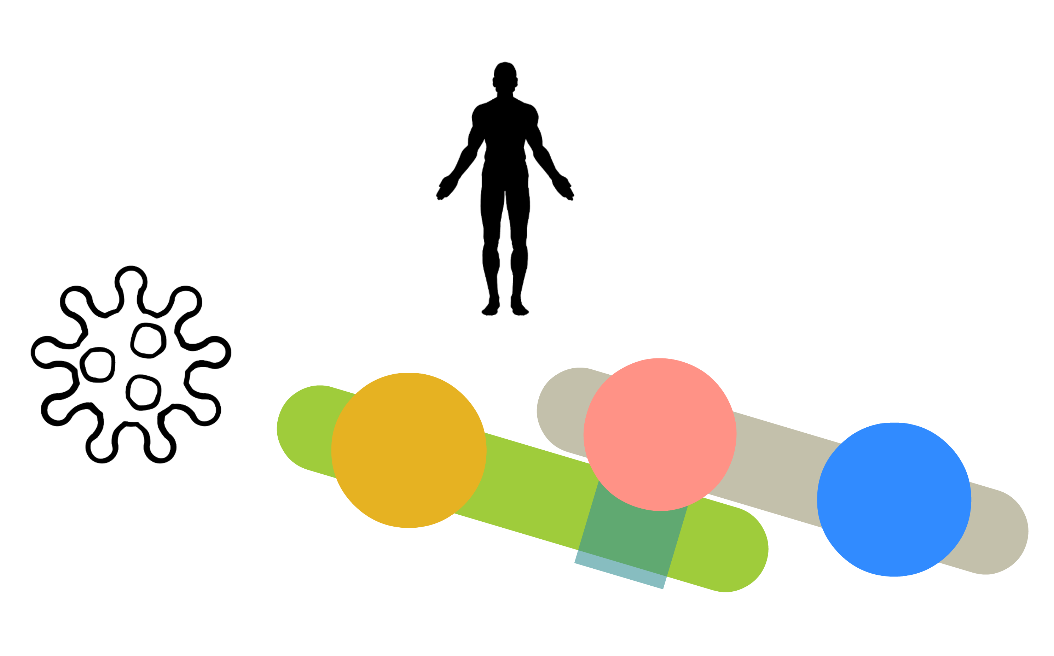
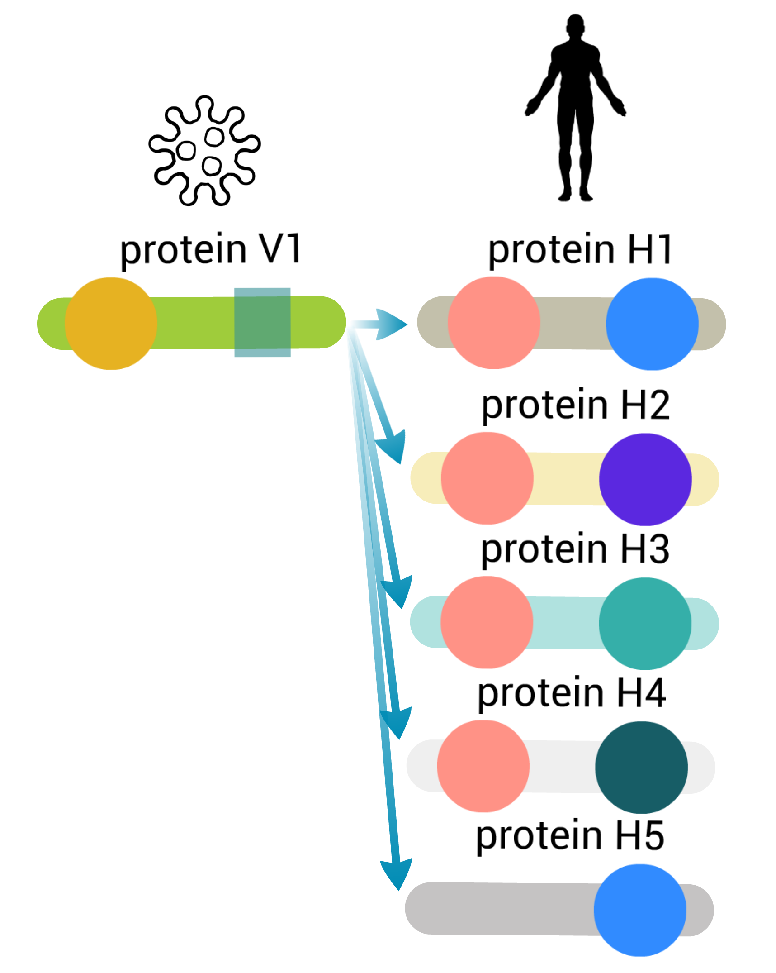


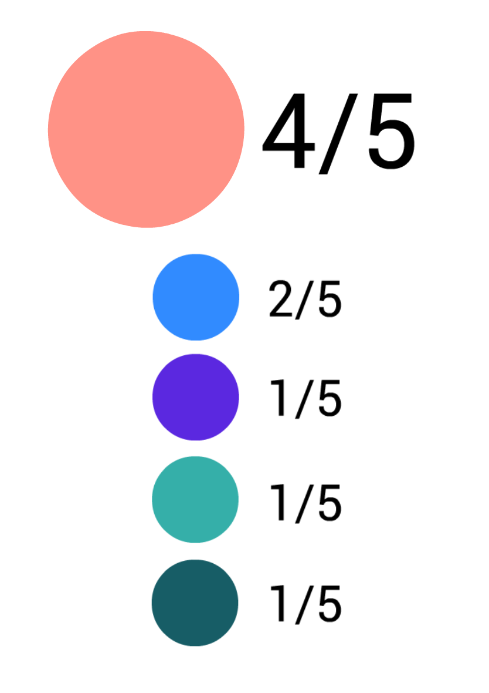

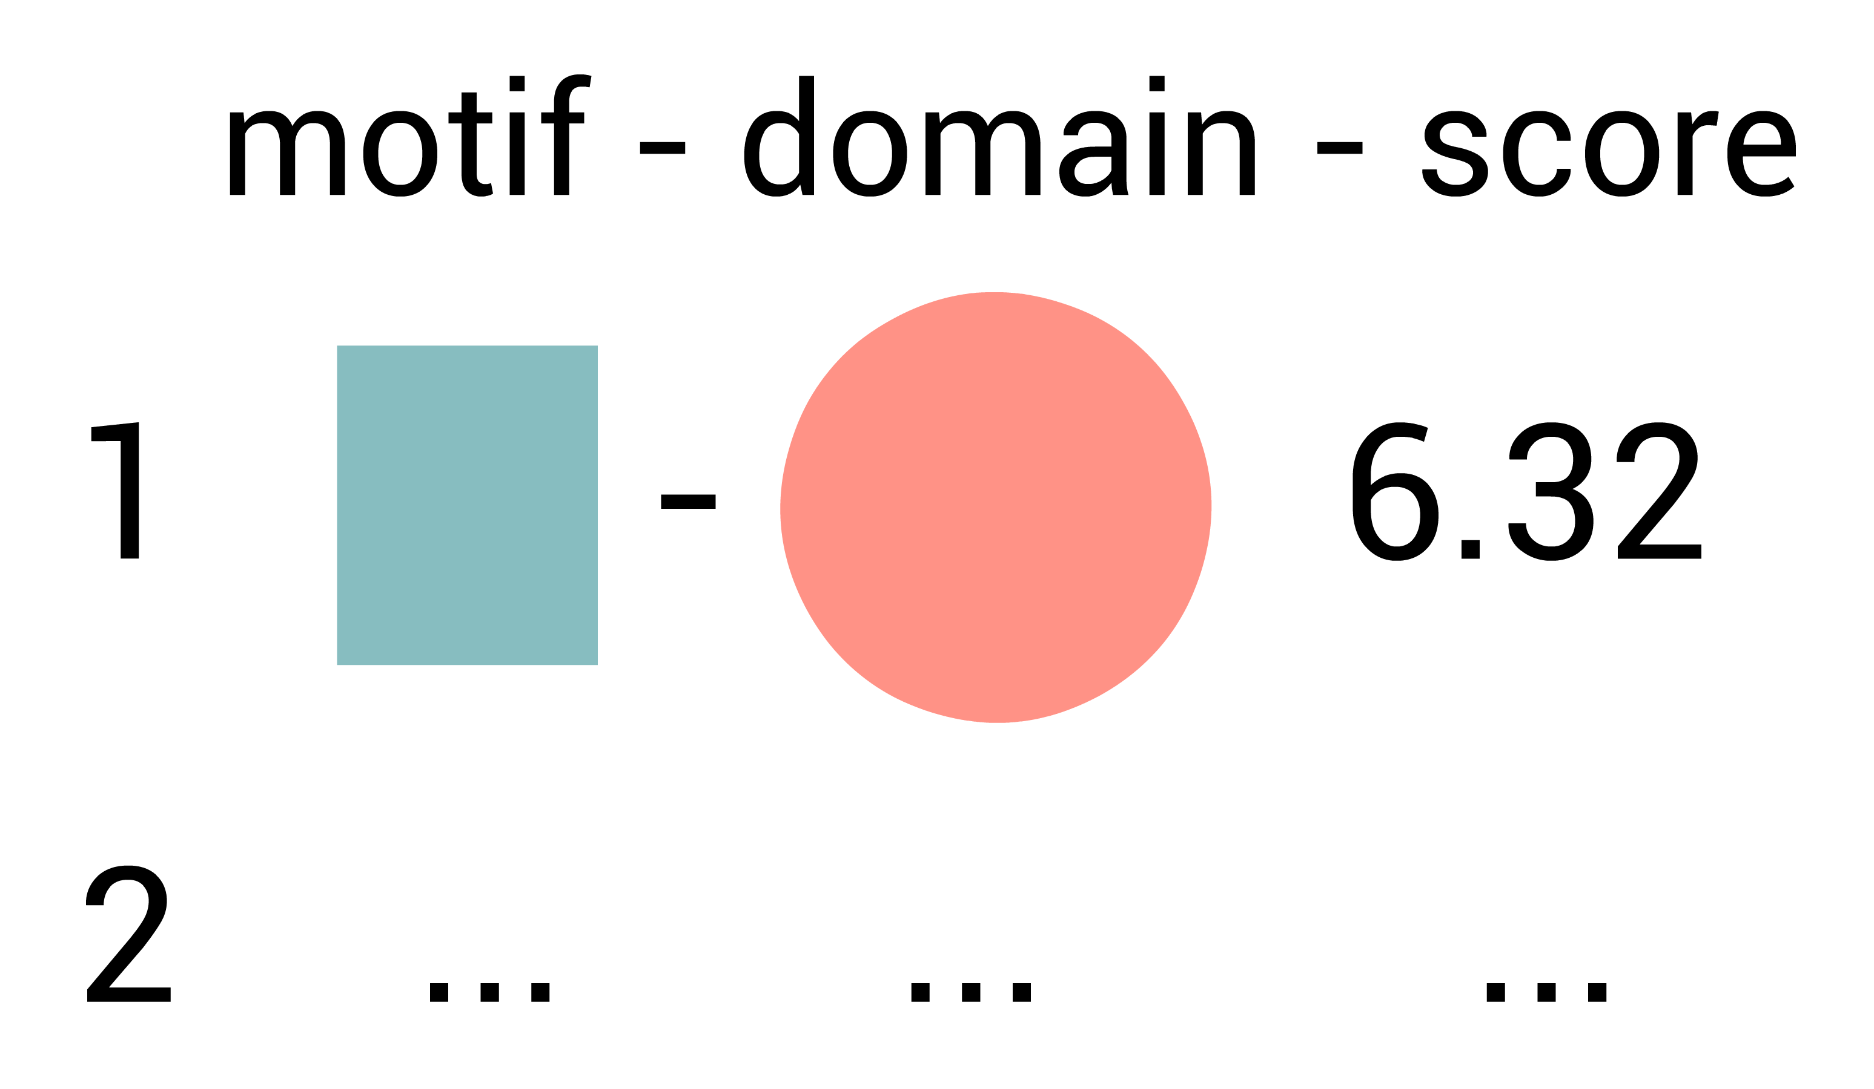

Overview
Globular
domains
1
We obtain protein
interaction data from
Linear
motif
We estimate which
domains are likely to
mediate interaction
3
2
We use to identify
known globular domains
We take interacting partners of
viral-interacting human proteins containing these domains and use QSLIMFinder to discover linear motifs de-novo
4
Benchmark based on known instances
and regions necessary to interact
and combine domain-motif pairs
5

Slide 3
Domains likely to mediate interaction are enriched in ELM domains
Notes:
The description of the method:
How many human proteins should contain a domain of interest out of all proteins that interact with a specific viral protein so that we can say with % confidence that a viral protein binds that domain.
Reflects the association between the total number of human proteins the viral protein interacts with and the fraction of these proteins containing a specific domain (Fisher's exact test doesn't account for this).
The rationale is that the number of human proteins that should contain a domain of interest for us to say with % confidence that a viral protein binds that domain changes as a viral protein gains more interacting partners. In a viral protein has only one human partner we cannot possibly identify which of the domains in that single protein are mediating interactions. Our ability to identify this domain grows a the degree of viral protein grows.

Slide 4
Domains likely to mediate interaction are enriched in ELM domains
Notes:
The description of the method:
How many human proteins should contain a domain of interest out of all proteins that interact with a specific viral protein so that we can say with % confidence that a viral protein binds that domain.
Reflects the association between the total number of human proteins the viral protein interacts with and the fraction of these proteins containing a specific domain (Fisher's exact test doesn't account for this).
The rationale is that the number of human proteins that should contain a domain of interest for us to say with % confidence that a viral protein binds that domain changes as a viral protein gains more interacting partners. In a viral protein has only one human partner we cannot possibly identify which of the domains in that single protein are mediating interactions. Our ability to identify this domain grows a the degree of viral protein grows.

Slide 5
Protein-domain pairs that are the least likely to occur by chance (Fisher’s Exact Test) are not enriched in ELM domains
Notes:
Protein-domain pairs that are the least likely to occur by chance according to the Fisher’s Exact Test are not enriched in ELM domains. Moreover, domains

